Slide 1
Sandboxing

Slide 2
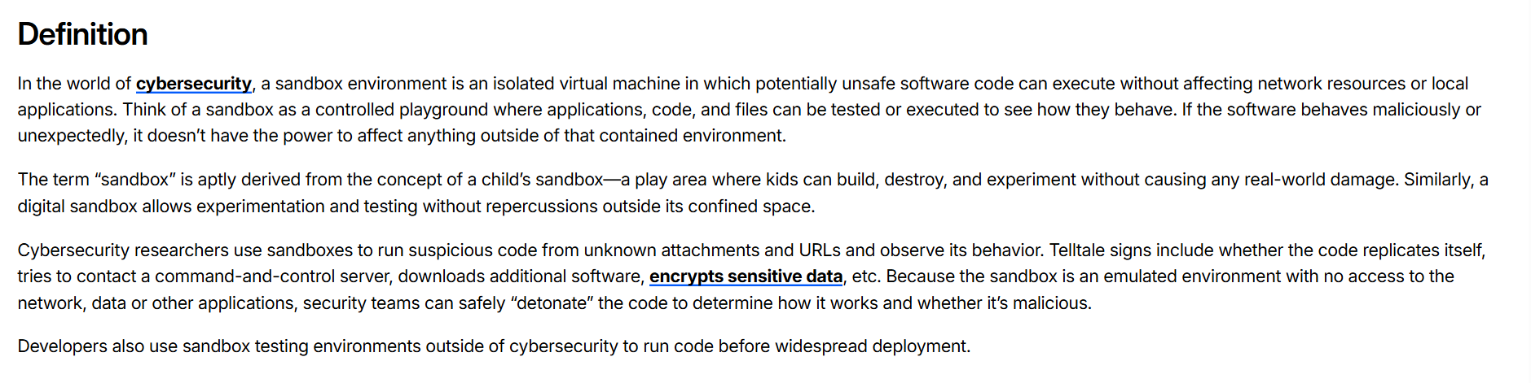

Slide 3
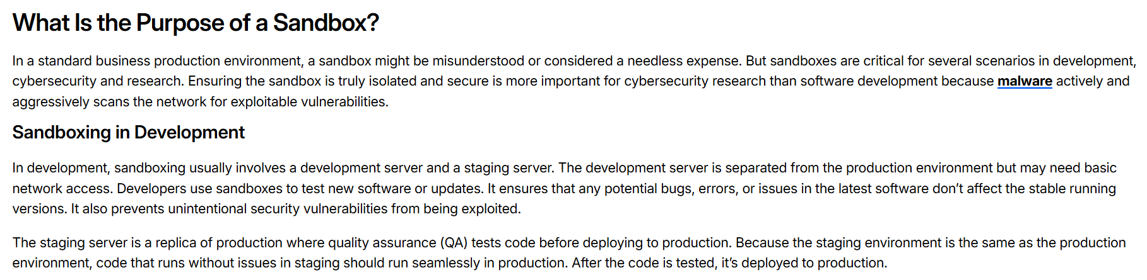

Slide 4
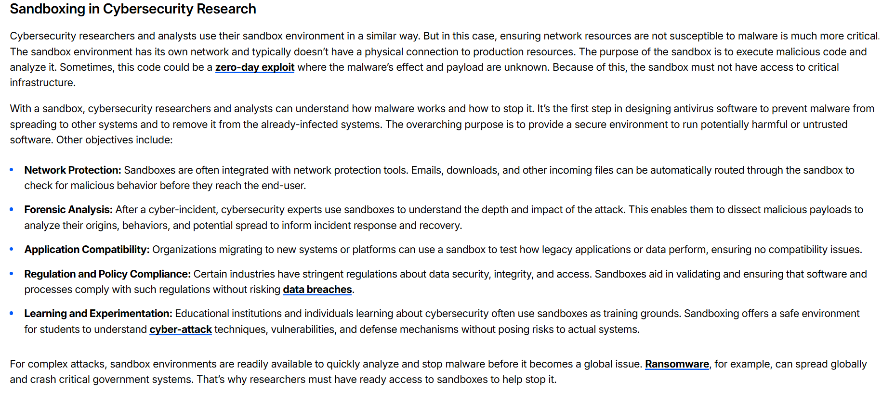

Slide 5
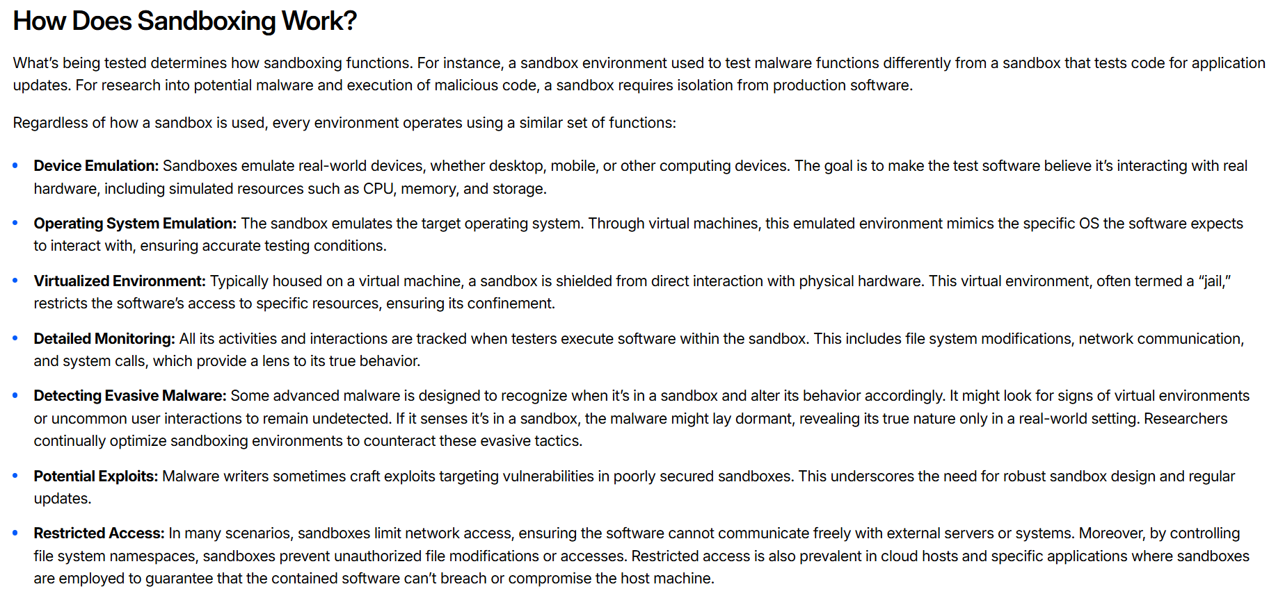

Slide 6
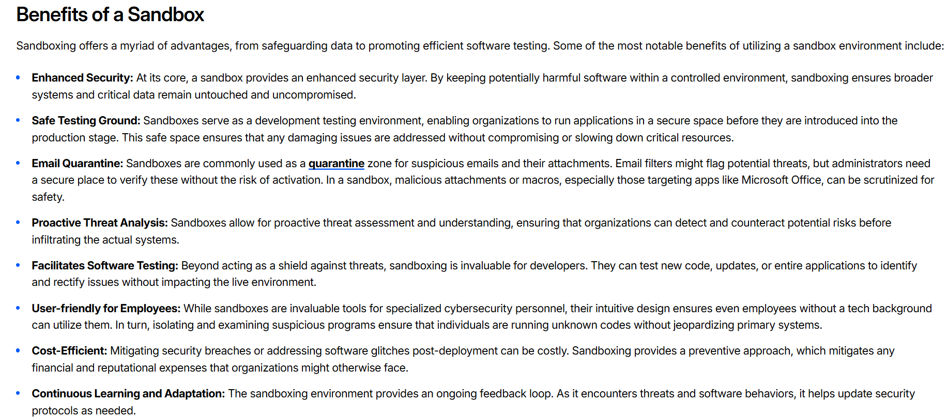

Slide 7
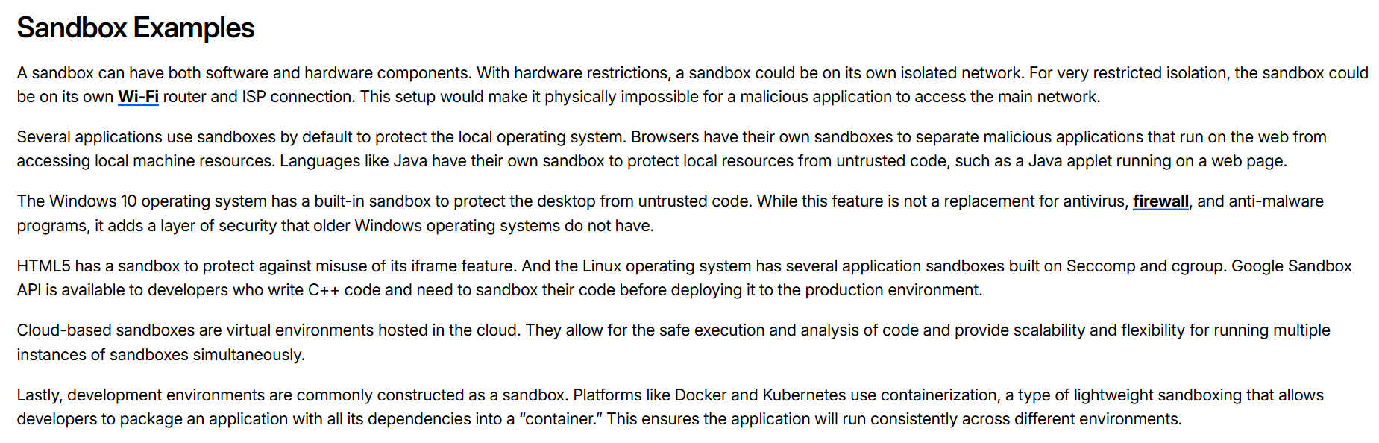

Slide 8
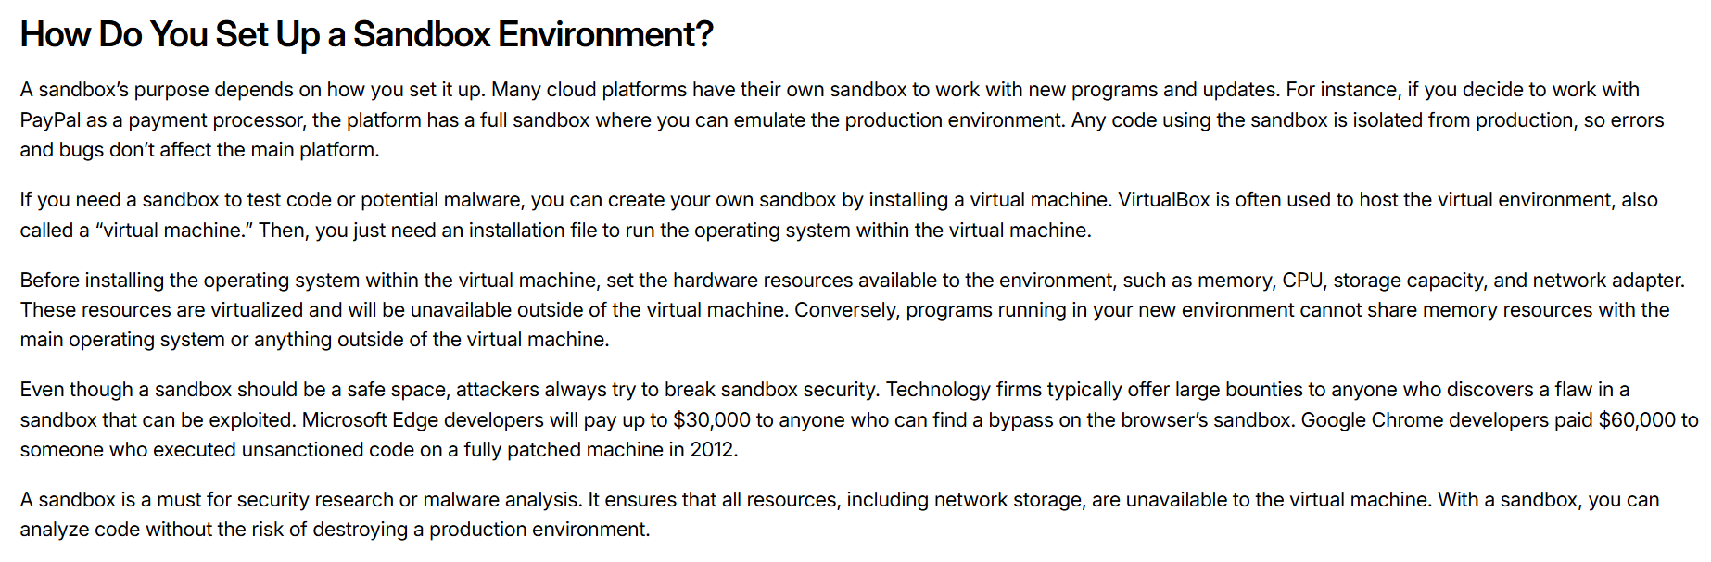

Slide 9
Thank you
Dr. Rachaita Dutta
Assistant professor
Dept. of mca
  9007223301
  rachaitadutta@my.amrita.edu

